Slide 1
MACHINE LEARNING

Slide 2
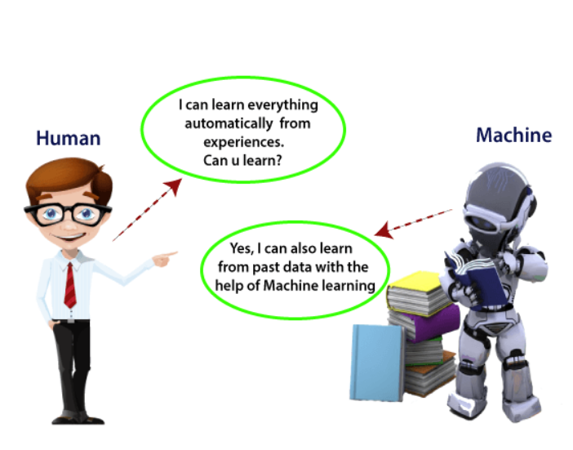

Slide 3
Machine learning is a branch of artificial intelligence (AI) and computer science which focuses on the use of data and algorithms to imitate the way that humans learn, gradually improving its accuracy.
Machine learning is a growing technology which enables computers to learn automatically from past data.
Machine learning uses various algorithms for building mathematical models and making predictions using historical data or information.
Used for various tasks such as image recognition, speech recognition, email filtering, recommender system, and many more.

Slide 4
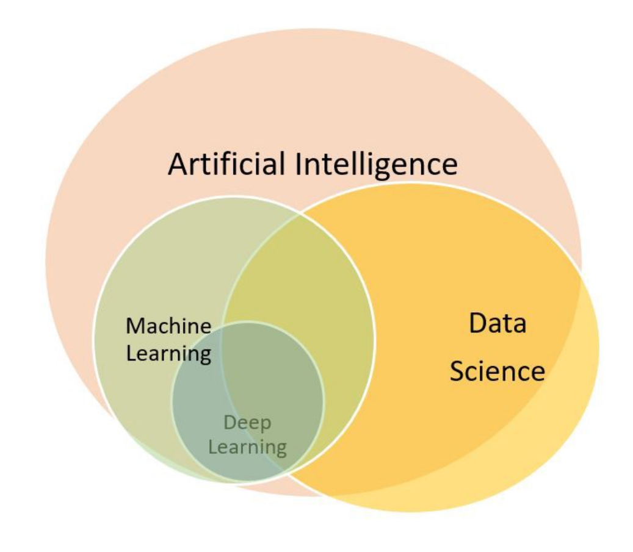

Slide 5
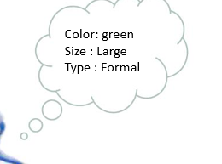

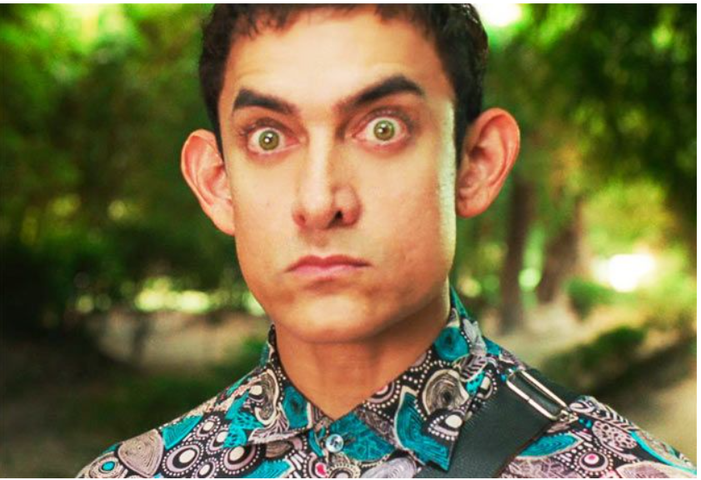
How a human being learn

Slide 6
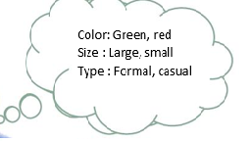
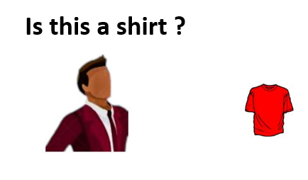





Slide 7
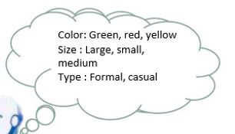



Slide 8
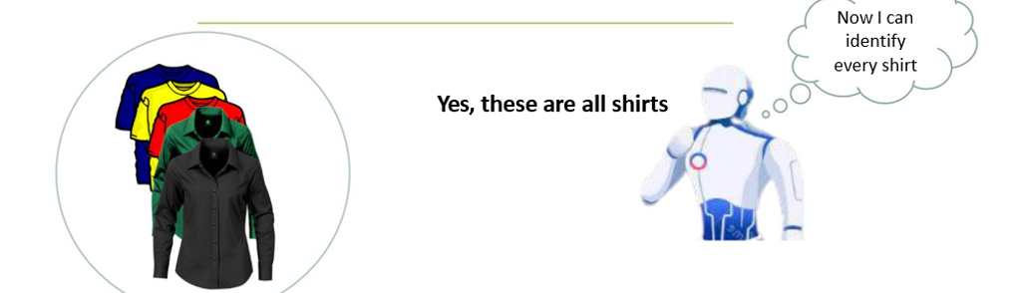

Slide 9
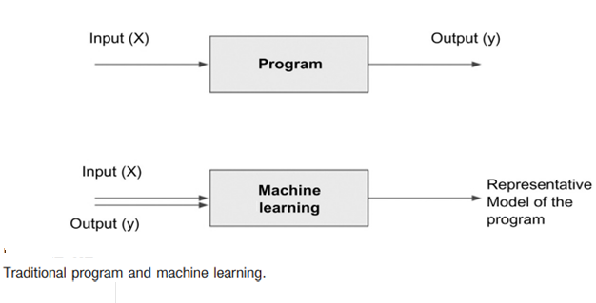

Slide 10
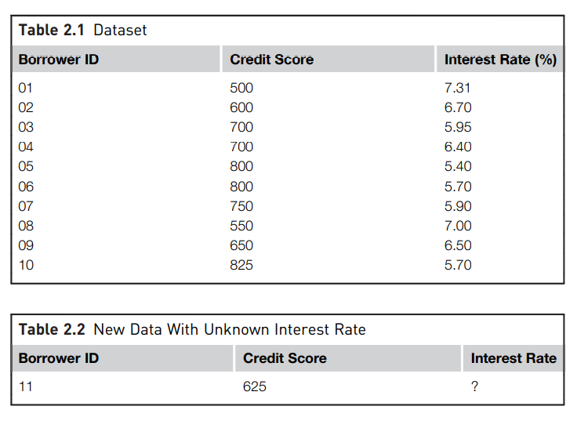

Slide 11
Pregnancies | Glucose | BloodPressure | SkinThickness | Insulin | BMI | DiabetesPedigreeFunction | Age | Outcome
6 | 148 | 72 | 35 | 0 | 33.6 | 0.627 | 50 | 1
1 | 85 | 66 | 29 | 0 | 26.6 | 0.351 | 31 | 0
8 | 183 | 64 | 0 | 0 | 23.3 | 0.672 | 32 | 1
1 | 89 | 66 | 23 | 94 | 28.1 | 0.167 | 21 | 0
0 | 137 | 40 | 35 | 168 | 43.1 | 2.288 | 33 | 1
5 | 116 | 74 | 0 | 0 | 25.6 | 0.201 | 30 | 0
3 | 78 | 50 | 32 | 88 | 31 | 0.248 | 26 | 1
10 | 115 | 0 | 0 | 0 | 35.3 | 0.134 | 29 | 0
2 | 197 | 70 | 45 | 543 | 30.5 | 0.158 | 53 | 1
8 | 125 | 96 | 0 | 0 | 0 | 0.232 | 54 | 1
4 | 110 | 92 | 0 | 0 | 37.6 | 0.191 | 30 | 0
10 | 168 | 74 | 0 | 0 | 38 | 0.537 | 34 | 1
10 | 139 | 80 | 0 | 0 | 27.1 | 1.441 | 57 | 0
1 | 189 | 60 | 23 | 846 | 30.1 | 0.398 | 59 | 1
5 | 166 | 72 | 19 | 175 | 25.8 | 0.587 | 51 | 1
7 | 100 | 0 | 0 | 0 | 30 | 0.484 | 32 | 1
0 | 118 | 84 | 47 | 230 | 45.8 | 0.551 | 31 | 1
7 | 107 | 74 | 0 | 0 | 29.6 | 0.254 | 31 | 1
1 | 103 | 30 | 38 | 83 | 43.3 | 0.183 | 33 | 0
1 | 115 | 70 | 30 | 96 | 34.6 | 0.529 | 32 | 1
3 | 126 | 88 | 41 | 235 | 39.3 | 0.704 | 27 | 0
8 | 99 | 84 | 0 | 0 | 35.4 | 0.388 | 50 | 0
7 | 196 | 90 | 0 | 0 | 39.8 | 0.451 | 41 | 1
9 | 119 | 80 | 35 | 0 | 29 | 0.263 | 29 | 1
11 | 143 | 94 | 33 | 146 | 36.6 | 0.254 | 51 | 1
10 | 125 | 70 | 26 | 115 | 31.1 | 0.205 | 41 | 1
7 | 147 | 76 | 0 | 0 | 39.4 | 0.257 | 43 | 1

Slide 12
A dataset is a collection of data with a defined structure.
This structure is also sometimes referred to as a “data frame”.
● A data point (record, object) is a single instance in the dataset. Each instance contains the same structure as the dataset.
● An attribute (feature, input, dimension, variable, or predictor) is a single property of the dataset. Attributes can be numeric, categorical, date-time, text, or Boolean data types.
A label (class label, output, prediction, target, or response) is the special attribute to be predicted based on all the input attributes. In Table interest rate is the output variable.

Slide 13
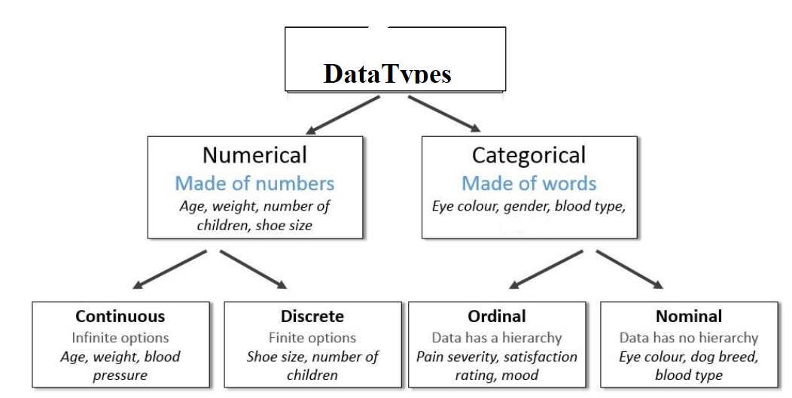

Slide 14
2 types of machine learning
Supervised Models
Supervised techniques predict the value of the output variables based on a set of input variables.
To do this, a model is developed from a training dataset where the values of input and output are previously known.
The model generalizes the relationship between the input and output variables and uses it to predict for a dataset where only input variables are known.
The output variable that is being predicted is also called a class label or target variable

Slide 15
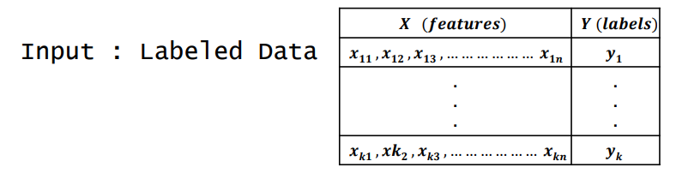
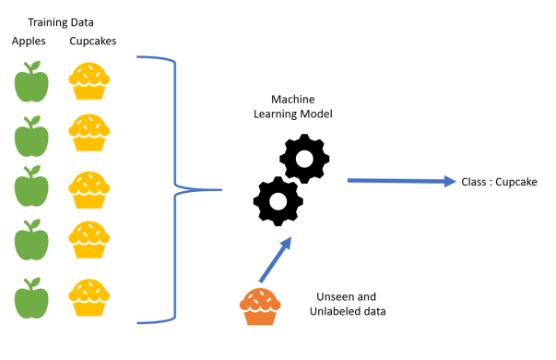

Slide 16
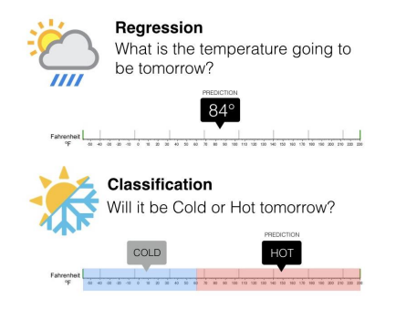
Classification and regression techniques predict a target variable based on input variables.
The prediction is based on a generalized model built from a previously known dataset. In regression tasks, the output variable is numeric. Classification tasks predict output variables, which are categorical.

Slide 17
Unsupervised Models
Unsupervised or undirected data science uncovers hidden patterns in unlabeled data.
In unsupervised data science, there are no output variables to predict.
The objective of this class of data science techniques, is to find patterns in data based on the relationship between data points themselves

Slide 18
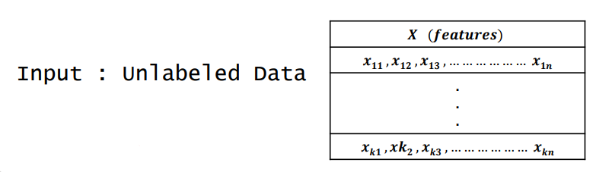
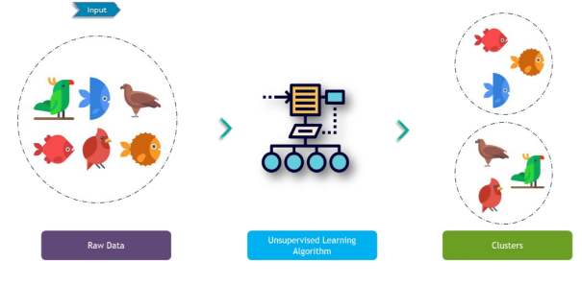

Slide 19
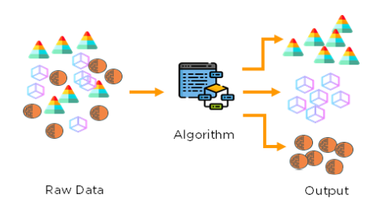
Clustering is the process of identifying the natural groupings in a dataset.

